Slide 1


Graph Neural Network and Anomaly Detection
图神经网络与异常检测
高静宜
2022/11/16

Slide 2
Content
01 Background
02 GNN Models
03 Self-supervised
04 Anomaly Detection

Slide 3
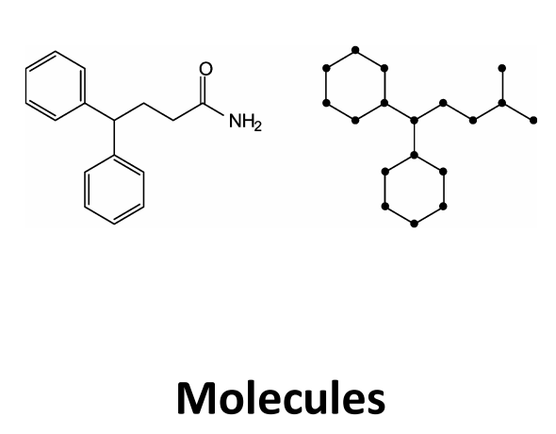
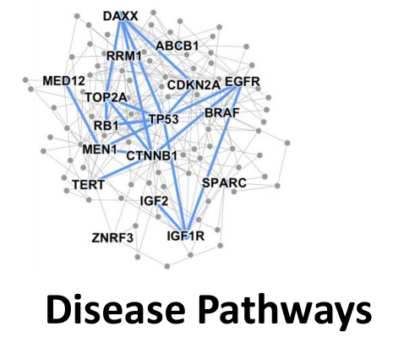

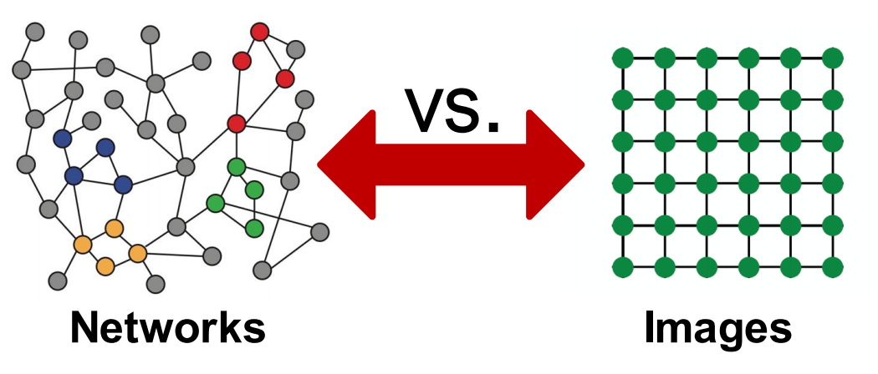
Background
why graphs
describe and analyze entities with relations
how to use the rich relational structure
problems: graph/edge/node-level

Slide 4
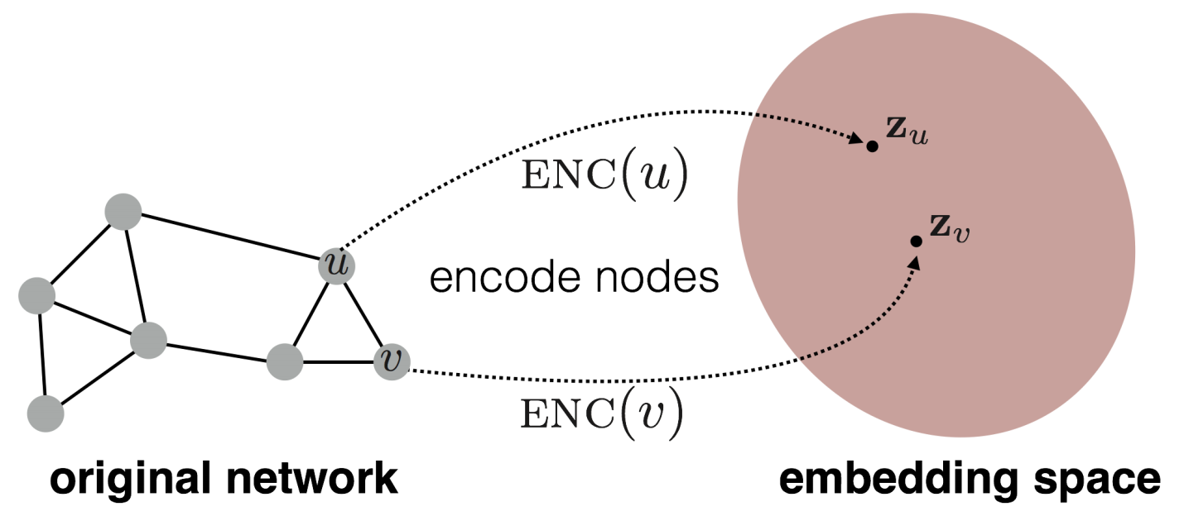
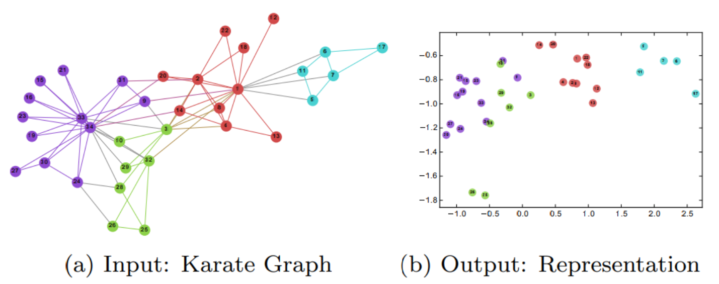
Background: graph representation learning
target: similarity in graph = embedding close
DeepWalk
RandomWalk （jump&restart）
word2vec : Skip-gram
DeepWalk: Online Learning of Social Representations KDD,2014

Slide 5
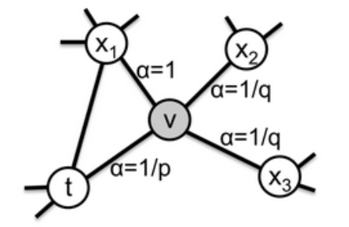
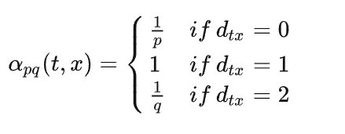
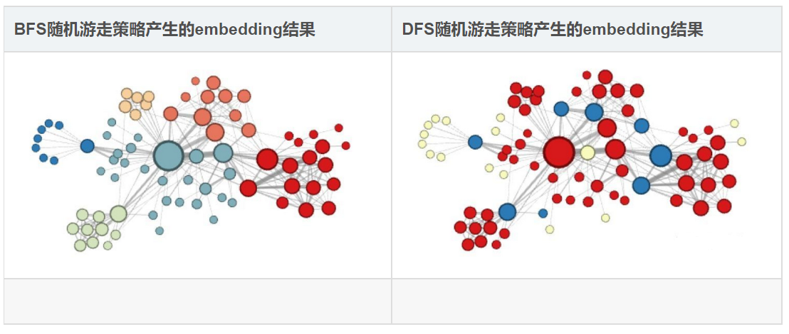
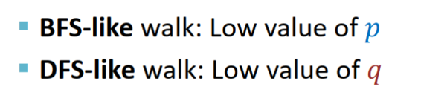
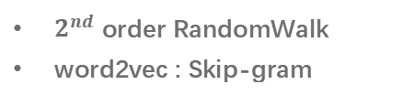
Background: graph representation learning
Node2Vec
$2^{nd}$ order RandomWalk
word2vec : Skip-gram
Where to go next?
node2vec: Scalable Feature Learning for Networks KDD,2016

Slide 6
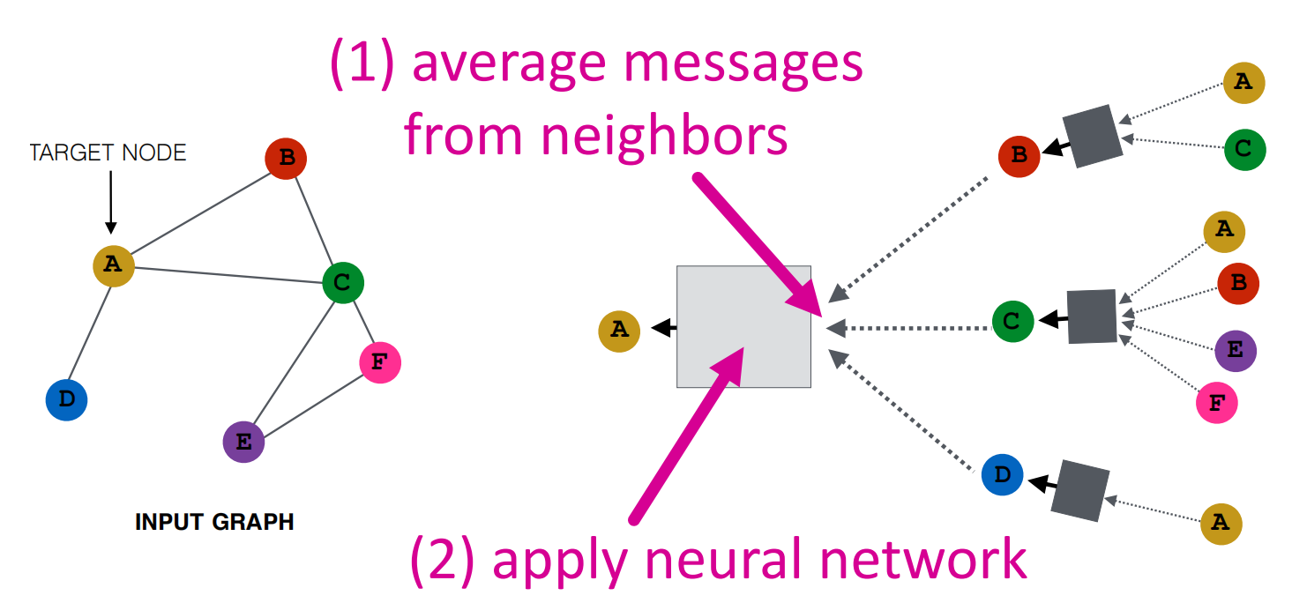
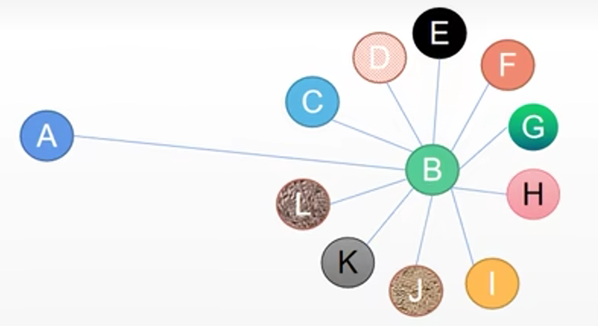
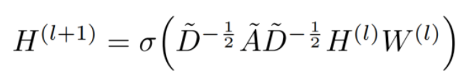
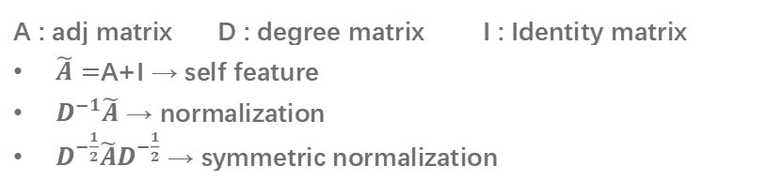
encoder: lookup → Neural network
GNN Models
key idea : generate node embedding based on local network neighborhoods
GCN
A : adj matrix D : degree matrix I : Identity matrix
$\tilde{A}=$A+I → self feature
$D^{−1}\tilde{A}$ → normalization
$D^{−\frac{1}{2}}\tilde{A}D^{−\frac{1}{2}}$ → symmetric normalization
Semi-Supervised Classification with Graph Convolutional Networks ICLR,2017

Slide 7
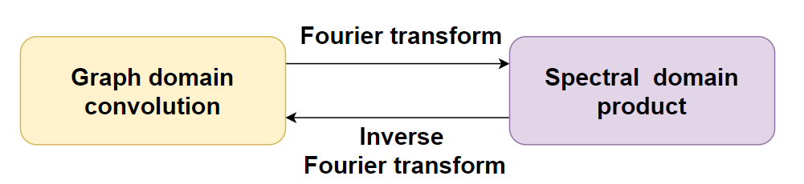
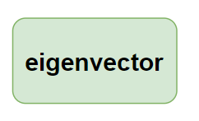
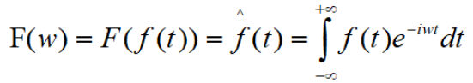
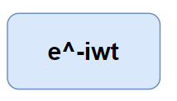
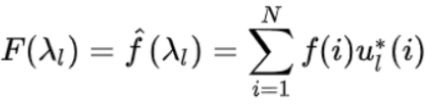
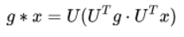
GNN Models
Spectral domain
For more : https://blog.csdn.net/kc7w91/article/details/127849689
Semi-Supervised Classification with Graph Convolutional Networks ICLR,2017

Slide 8
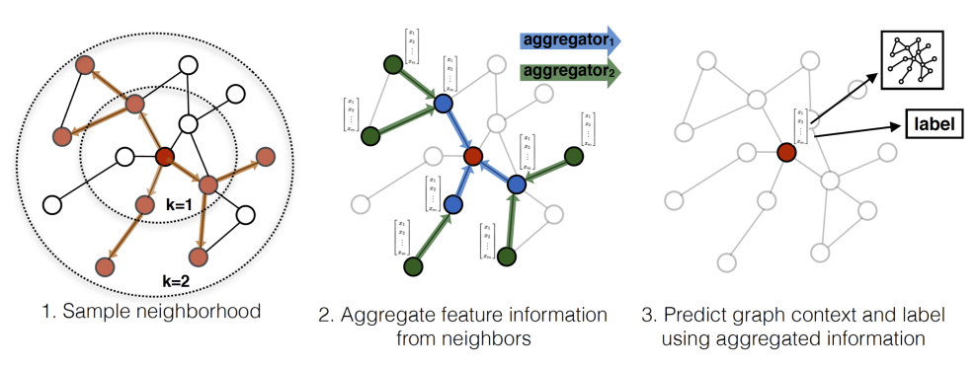
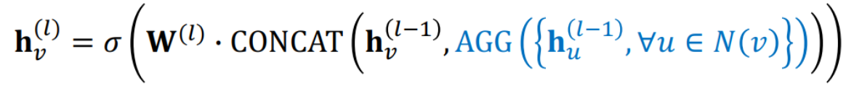
GNN Models
GraphSAGE
sample (S)
different AGGs : mean/pooling/LSTM
unsupervised loss :
Inductive Representation Learning on Large Graphs NeurIPS,2017

Slide 9
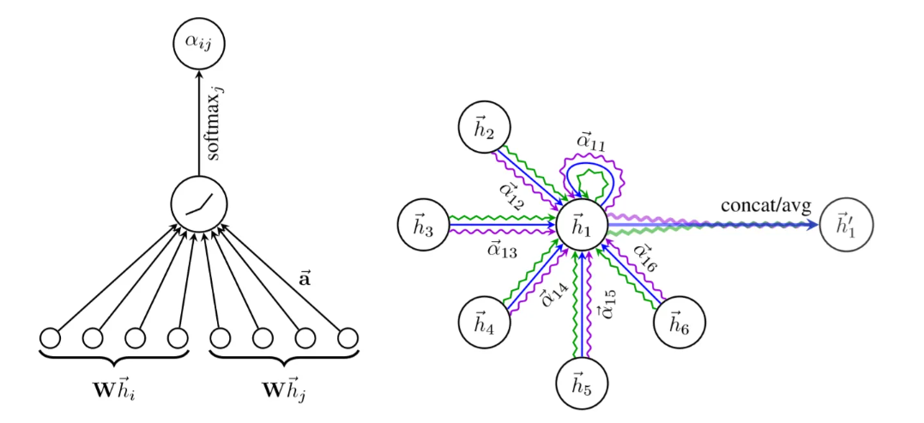
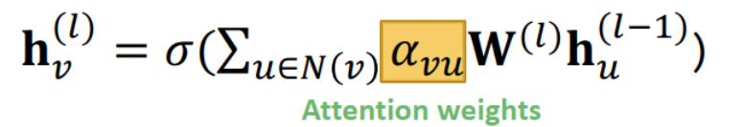
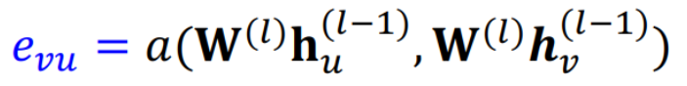
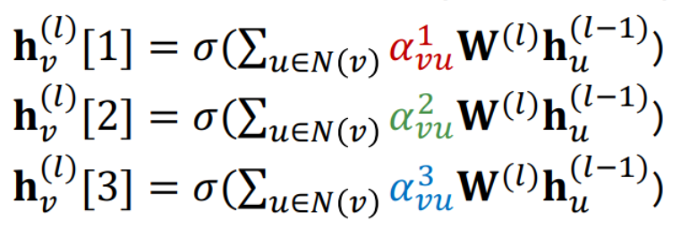
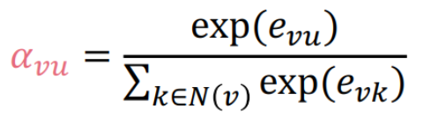
GNN Models
GAT
aggregate according tocontribution
muti-head
Graph Attention Networks ICLR,2018

Slide 10
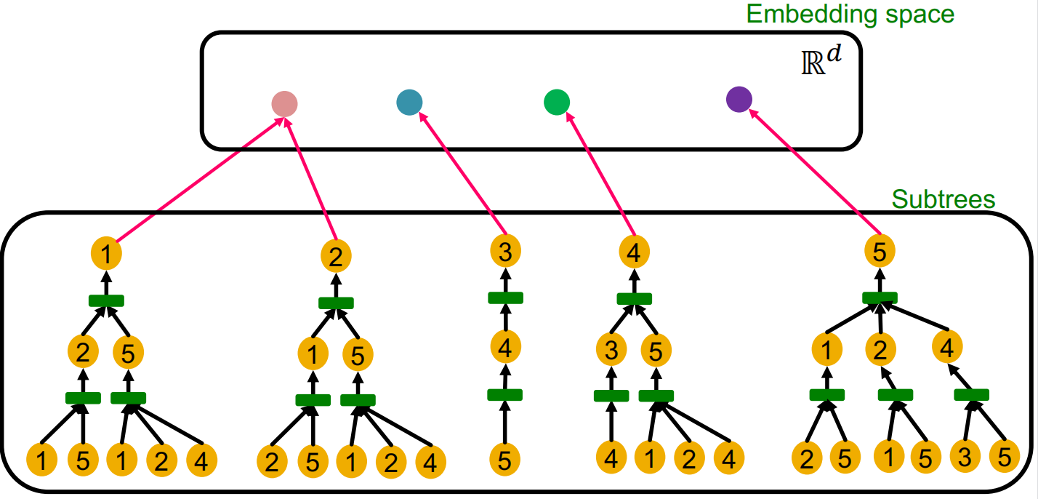
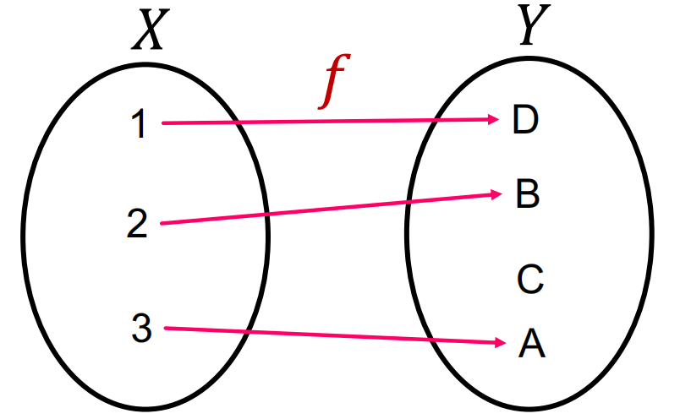
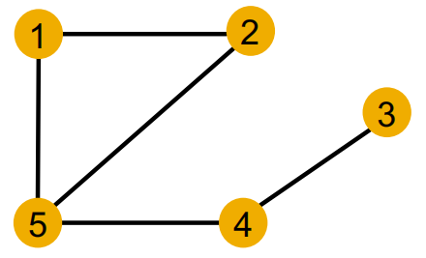
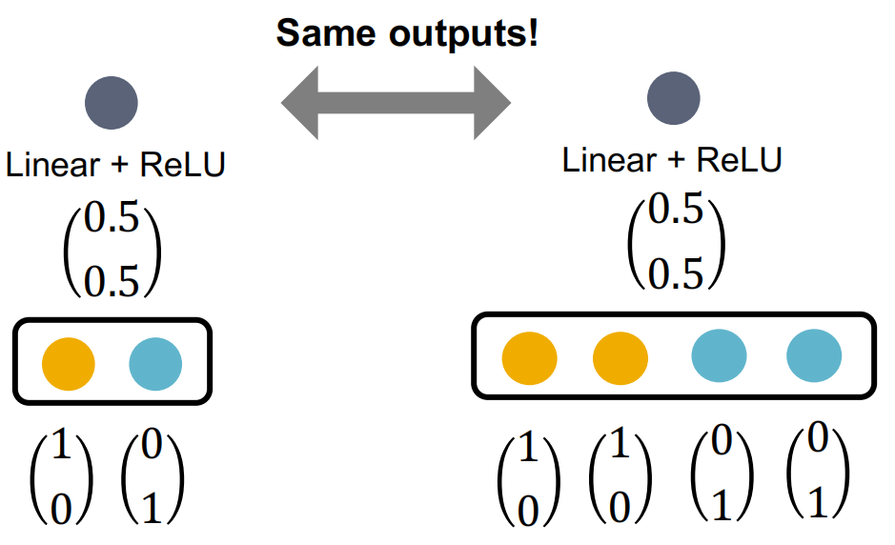
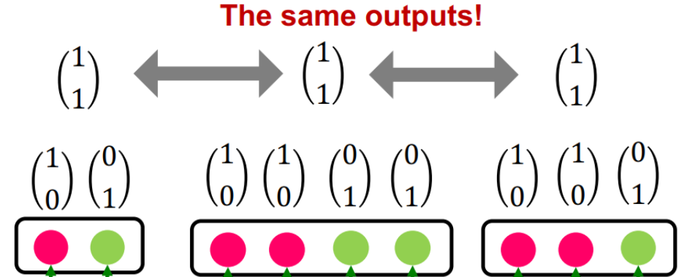
GNN Models
GIN
Why GCN cannot?
How Powerful are Graph Neural Networks? ICLR,2019
Why GraphSAGE cannot?

Slide 11
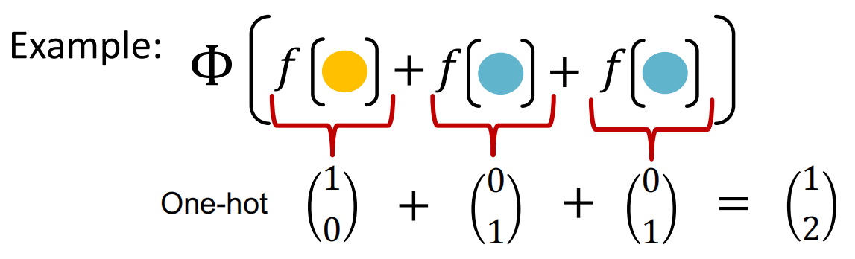
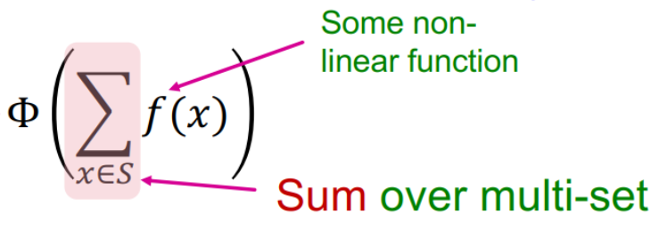
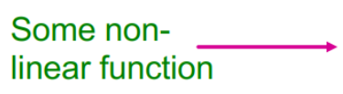
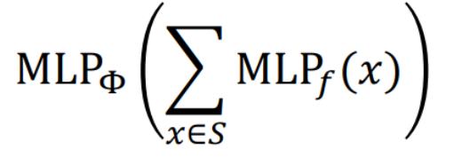
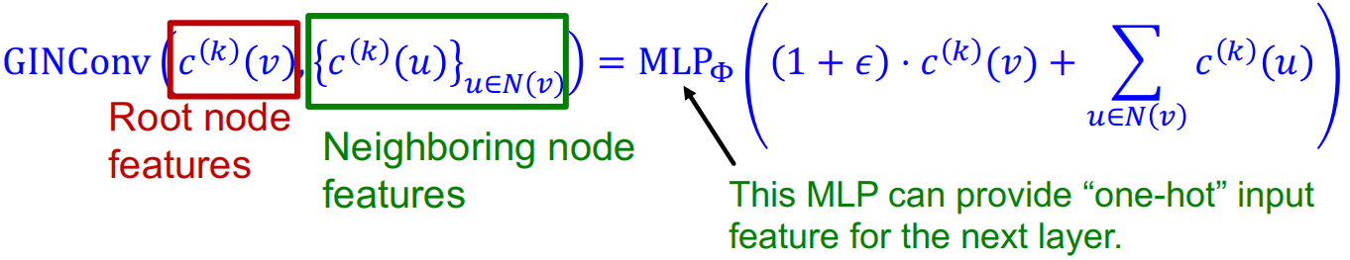
GNN Models
GIN
universal approximation theorem：MLP
How Powerful are Graph Neural Networks? ICLR,2019

Slide 12
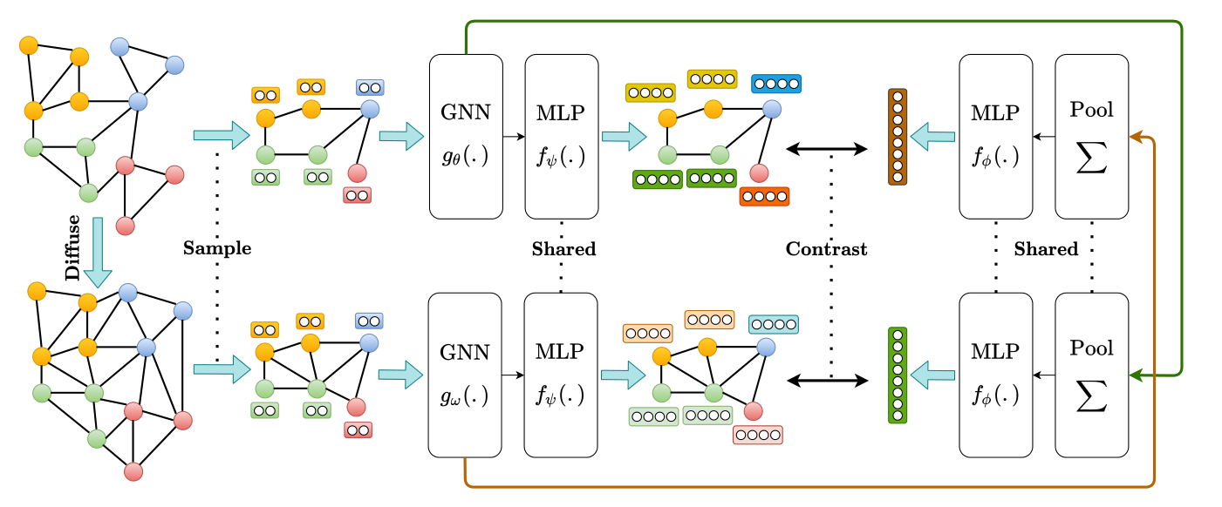
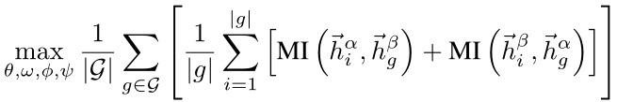
Self-supervised
MVGRL
original view
diffuse view
loss : deep InfoMAX
Contrastive Multi-View Representation Learning on Graphs ICML,2020

Slide 13
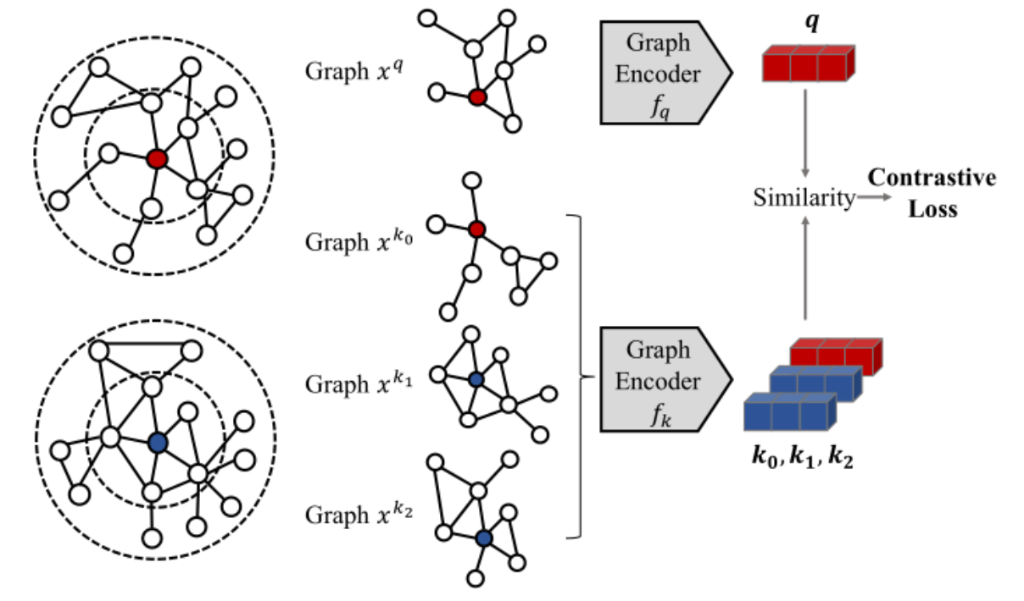
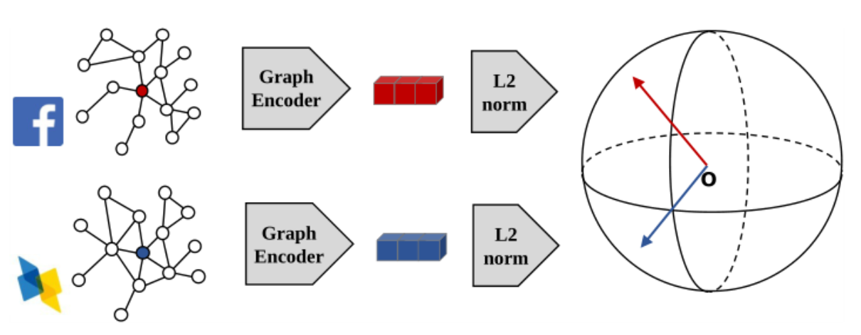
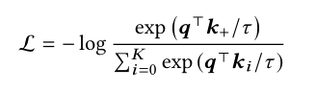
Self-supervised
Pretrained model: GCC
pretrain
sample
encode (GIN) : Generalized positional embedding
loss
fine tuning
freezing
full fine-tuning
GCC: Graph Contrastive Coding for Graph Neural Network Pre-Training KDD,2020

Slide 14
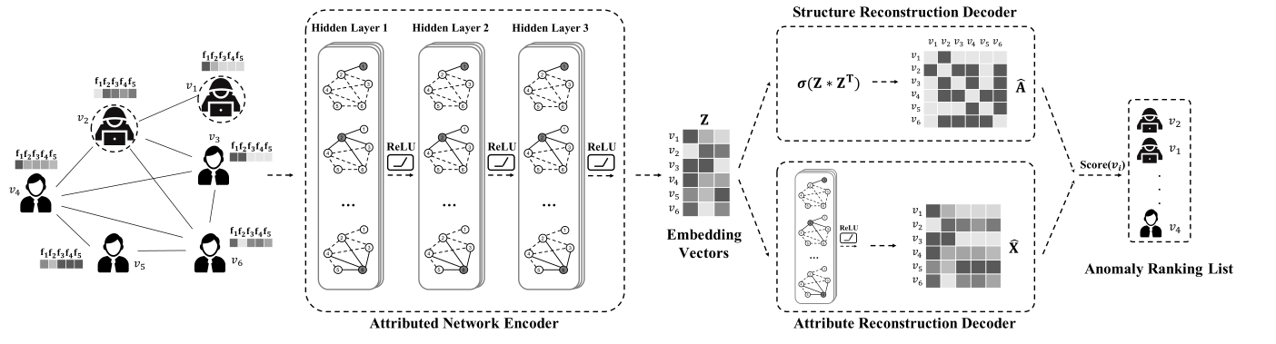
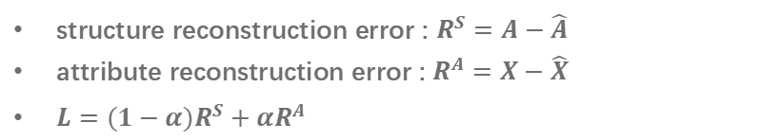
Anomaly Detection
DOMINANT
structure reconstruction error : $R^{S}=A−\hat{A}$
attribute reconstruction error : $R^{A}=X−\hat{X}$
$L=(1−α)R^{S}+αR^{A}$
Deep Anomaly Detection on Attributed Networks SDM,2019

Slide 15
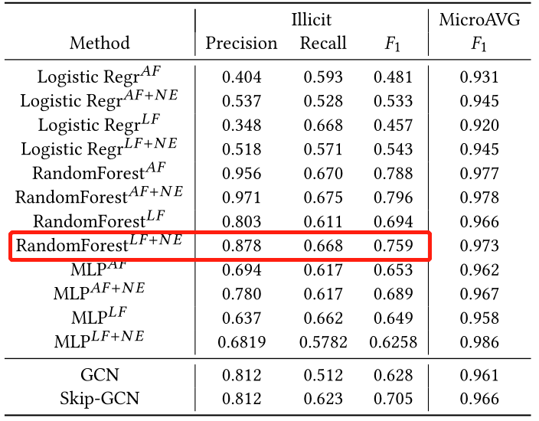
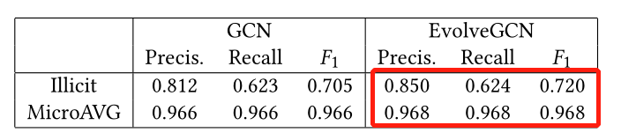
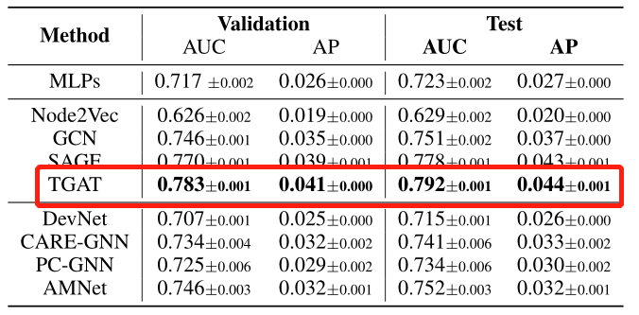
Anomaly Detection
ELLIPTIC
203769 nodes
234355 edges
166 features
1 : 0 : un = 2 : 21 : 77
Anti-Money Laundering in Bitcoin: Experimenting with Graph Convolutional Networks for Financial Forensics KDD,2019
DGraph
3700550 nodes
4300999 edges
17 features
1 : 0 : un = 0.41 : 31.79 : 66.8
DGraph: A Large-Scale Financial Dataset for Graph Anomaly Detection NeurIPS,2022

Slide 16
Anomaly Detection
Our project & problems
construction of graph : exchanges addresses
too many unlabeled data : 770 vs millions
unbalanced label : no exact negative sample
how to tackle BIG graph : torchTensor / special framework
explainable : How to be convincing

Slide 17
THANKS

